Slide 1
Basics of React + MUX
An introductory lesson in modern front-end engineering at Manulife
Presenters Brooke Bailey, Catherine Ellingham, Muthu Chellappa, and Sean Donnellan

Slide 2
React
A JavaScript library for building user interfaces
Easy to create dynamic web apps
Mobile applications also easy via React Native
Declarative development
Devs define how the UI should look according to user interactions
React takes care of updating the view (Virtual DOM)
Relies on reusable components to build web pages
Libraries such as Material UI or Manulife’s MUX library provide predefined components and more, freeing up devs to focus on functionality not form
Very popular, relatively easy to learn
Large community of developers
Numerous reliable 3rd party libraries
Built by Facebook, maintained by Meta
https://react.dev/ https://opensource.fb.com/projects/react/

Slide 3
MUX
MUX is a React component library
Prebuilt React components, hooks, and utilities
Plug-n-play React extension for UI
Modern design best practices that follows our brand guidelines
Removes a lot of the “busy work” a dev would need to do in a raw React app
Styling, Accessibility, Responsive Design, Icons, Event Handling, browser specifics, following industry UI standards, etc…
Enables Devs & Designers to work faster
Excellent support
Internal library allows us to directly ask questions of the developers and maintainers of this library via Teams
MUX: https://mux.manulife.com/ CDS: https://design.manulife.com/ Teams Channel: Engineering | topic-mux | Microsoft Teams

Slide 4
Demo React + MUX

Slide 5
Prerequisites
Provide us with your Github usernames (so we can grant you access to the repo)
Paste it in this meetings teams chat

Slide 6
Prerequisites
Mac Users open Terminal
Confirm Git is installed `git -v`
Confirm Node is installed `node -v`
If you see a Git and Node version number: STOP
Confirm Homebrew is installed `brew --version`
If you don’t see a Homebrew version number, install Homebrew with `/bin/bash -c “$(curl -fsSL https://raw.githubusercontent.com/Homebrew/install/HEAD/install.sh)”`
Install Node by running `brew install node`
Install Git by running `brew install git`
STOP
Windows Users open CMD
Confirm Git is installed `git -v`
Confirm Node is installed `node -v`
If you see a Git and Node version number: STOP
Confirm WinGet is installed `winget -v`
If you don’t see a WinGet version number, raise your hand for assistance
Install fnm `winget install Schniz.fnm`
Configure fnm `fnm env --use-on-cd | Out-String | Invoke-Expression`
Install Node.js `fnm use --install-if-missing 20`
Install Git `winget install --id Git.Git -e --source winget`
STOP

Slide 7
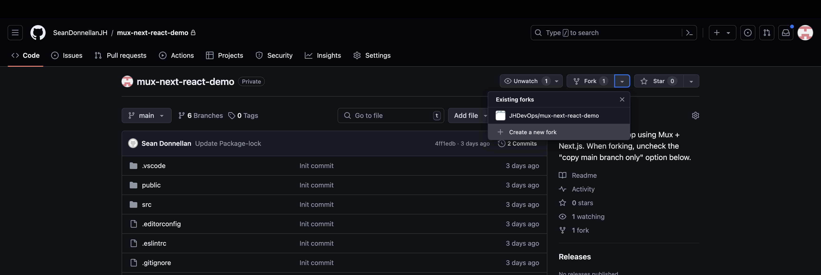
Setup
Go here after receiving access: https://github.com/SeanDonnellanJH/mux-next-react-demo
Click the down arrow next to “Fork”
Click “+ Create a new fork”
STOP

Slide 8
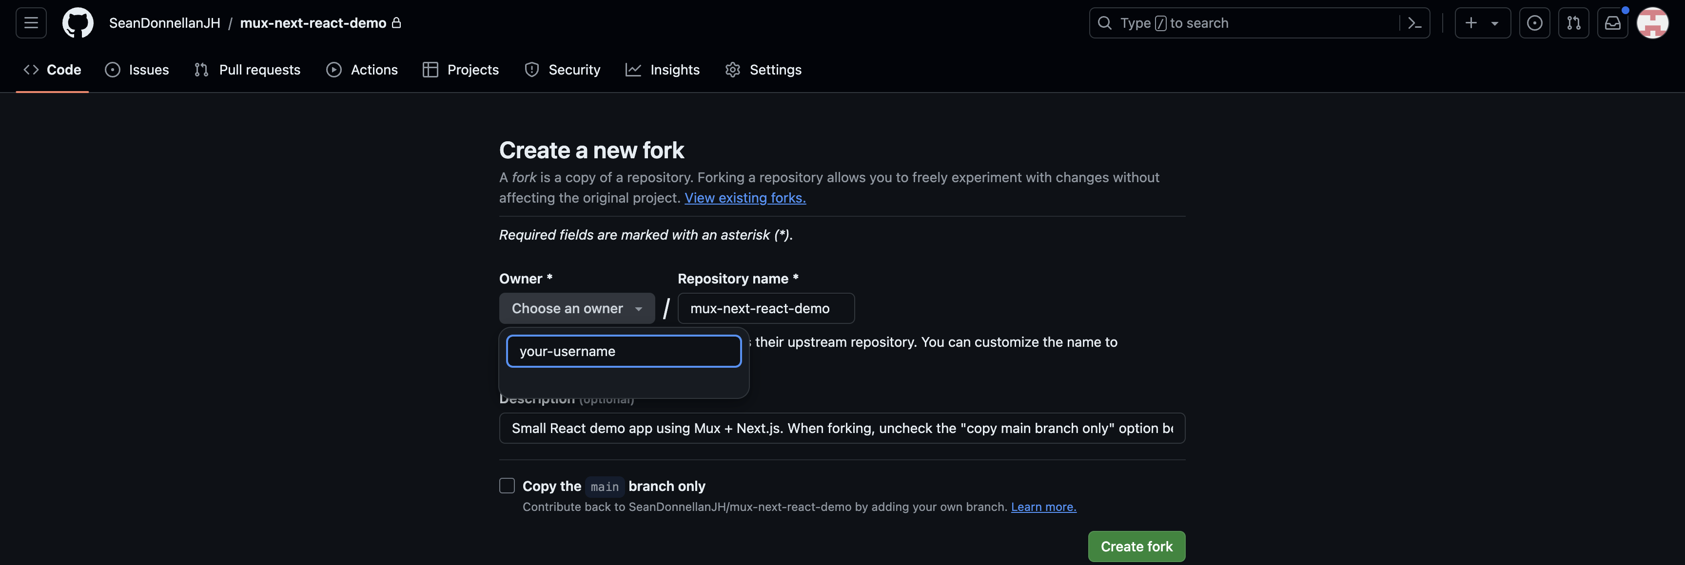
Setup
Click the “Owner” dropdown: Choose your username
Uncheck “Copy the main branch only”
Click Create fork
STOP

Slide 9
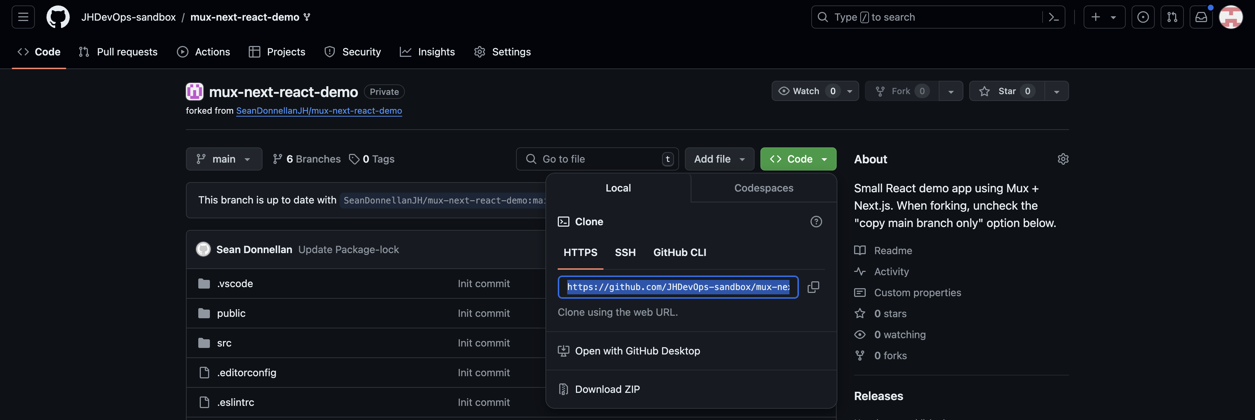
Setup
Confirm you are on your forked repository
It will say “forked from SeanDonnellanJH/mux-next-react-demo” beneath the title
Click on Code
Select HTTPS
Copy that URL
STOP

Slide 10
Setup
In your terminal, Run the following:
`git clone URL` (using the HTTPS URL you copied in the previous step)
`cd mux-next-react-demo` (or whatever name you gave your forked repo)
`git branch` to observe all the steps in this tutorial and press `Q` to exit
`git checkout step-0-empty`
`npm install` and wait
`npm run build` and wait
`npm start` and open http://localhost:3000/demo
You can stop with `control + C` – useful if you don’t see your changes appearing on the webpage, you may need to restart by stopping and starting again
In VS Code, navigate to `mux-next-react-demo/src/app/demo/page.js`
This is where we will conduct our entire tutorial

Slide 11
Tutorial Overview
Core Concepts
Adding reusable MUX components to a page
Managing state within an app
Event Handling
Conditional Props
Using useEffect for page load events
Using useEffect for dependency events
Please raise your hand if you are stuck so someone can assist you.
If we move on to the next core concept but your code is not working, you can checkout that branch to quickly catch up – like save points.
Example: if we begin “4. Conditional Props” and you are not done with step 3, you can run `git checkout step-3-event-handling` and be caught up with everyone else – the catch-up command will be at the top of each slide

Slide 12
IMPORTANT: Between each step, you must…
Save your work
Quit running npm start with `Control + C` in the terminal
Run `npm run build`
Run `npm start`
Otherwise you won’t see your changes appear on the page – unfortunately, refreshing the page is not enough
Catch up command: `git checkout step-0-empty`

Slide 13
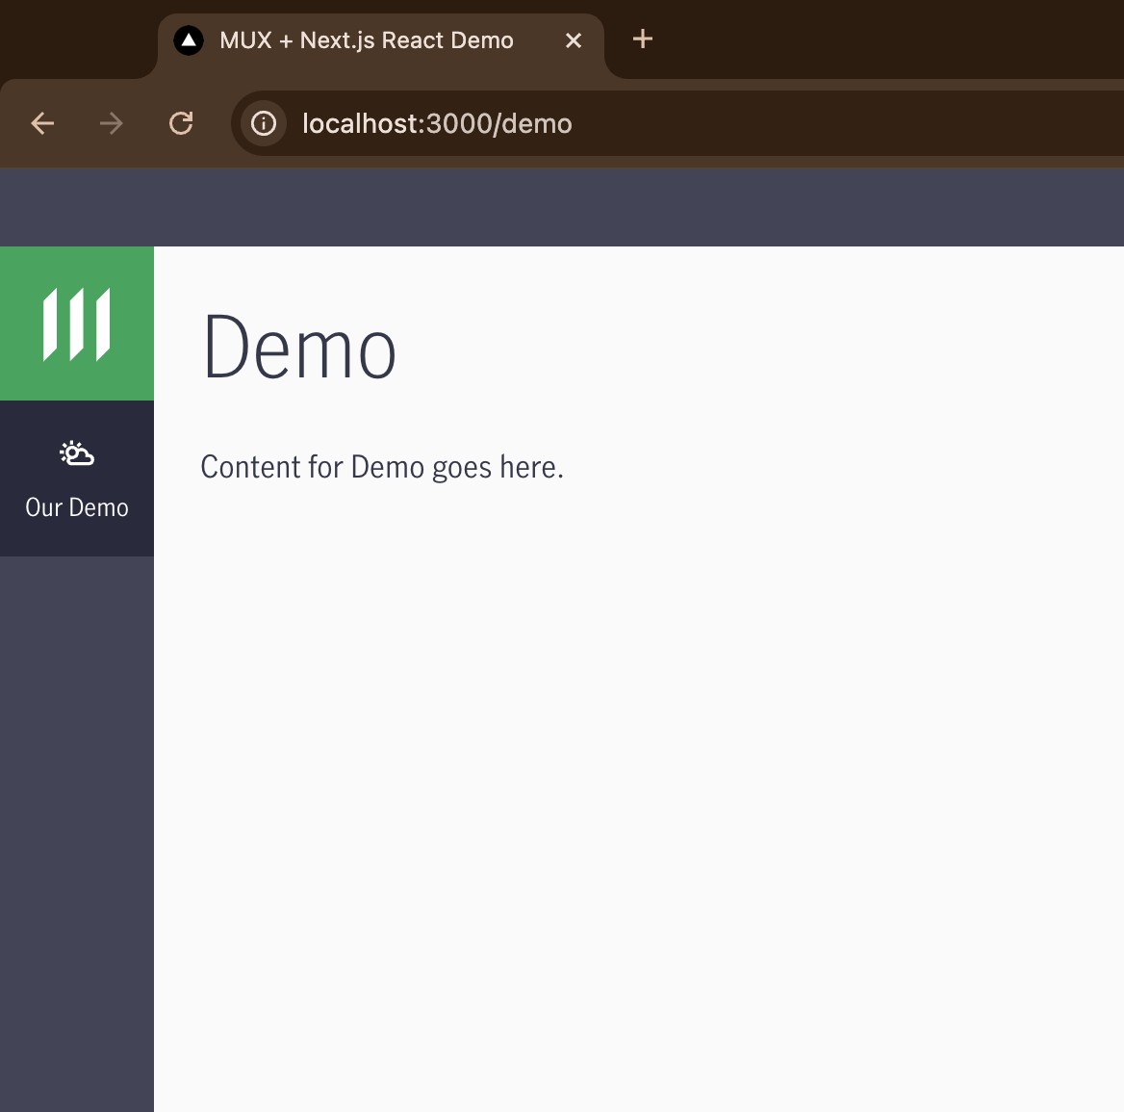
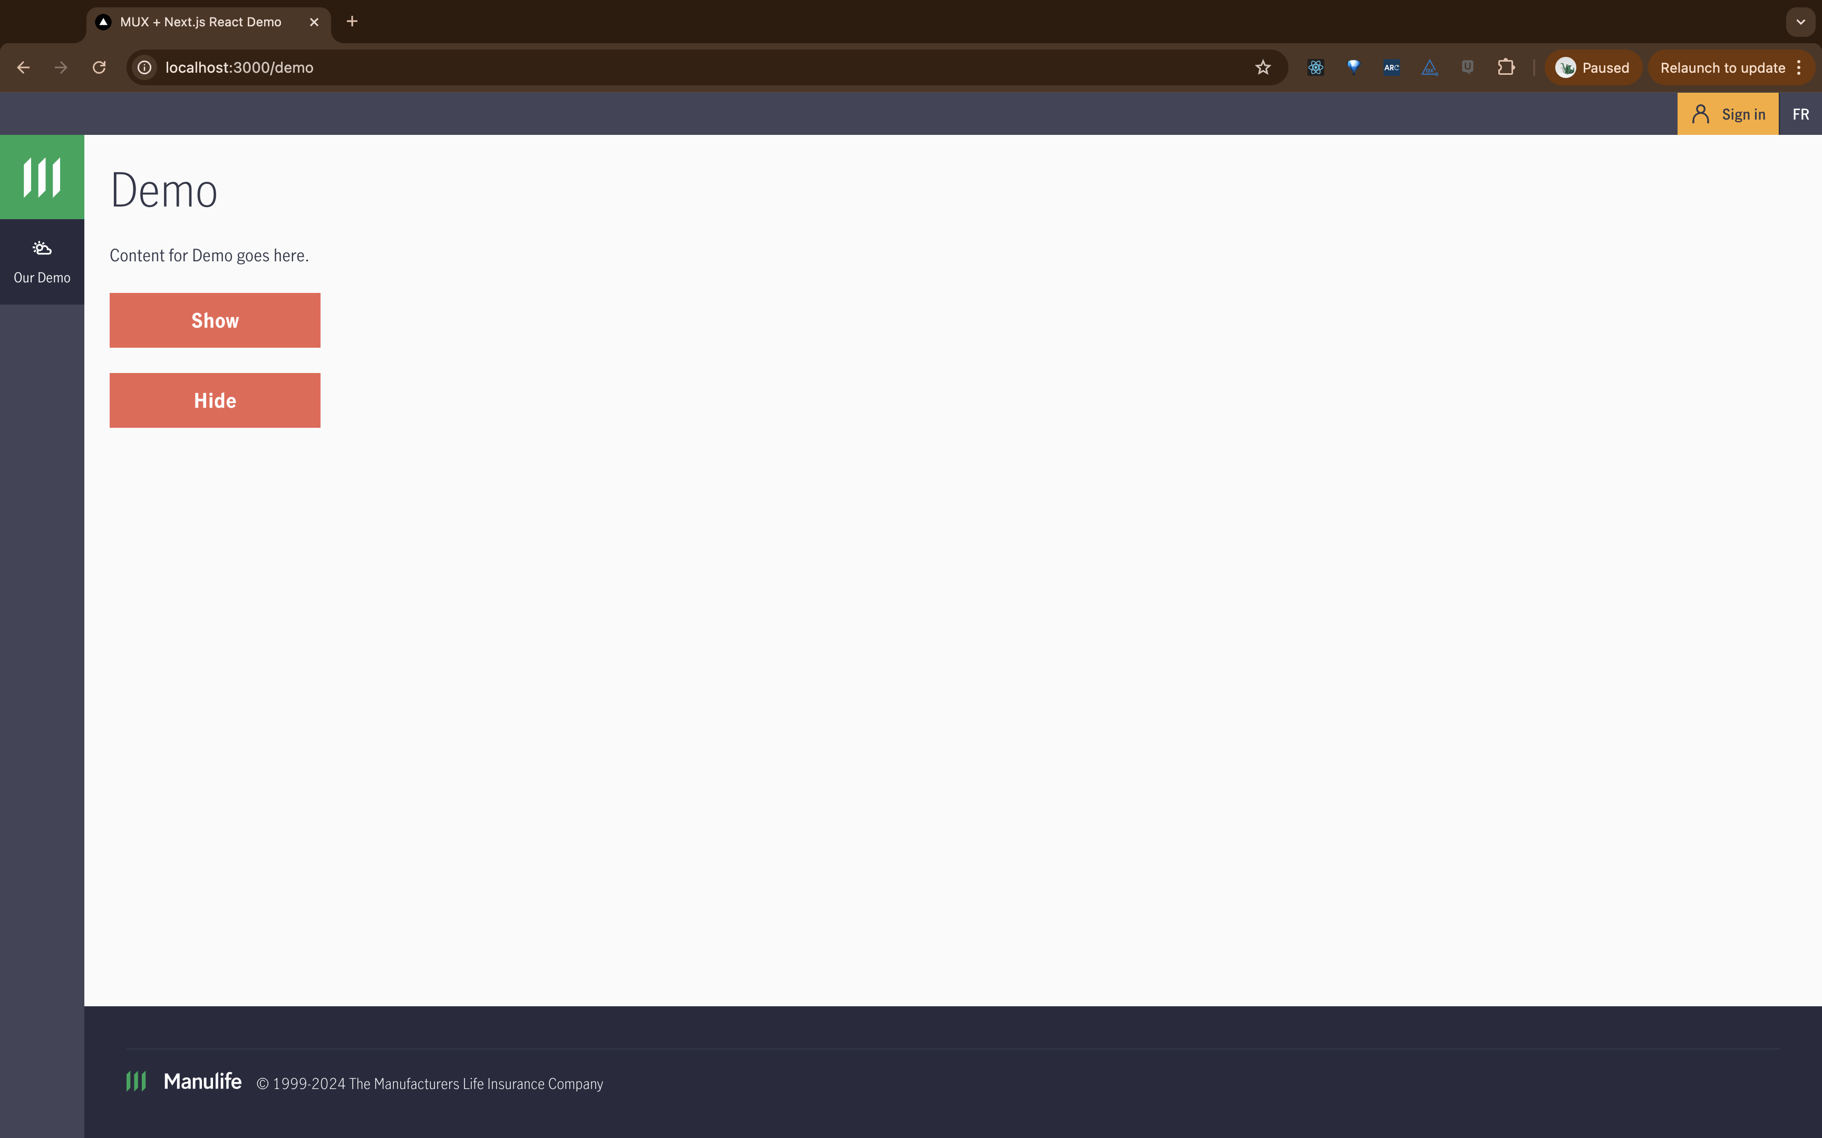
1. Adding reusable MUX components to a page
Catch-up command: `git checkout step-0-empty`

Slide 14
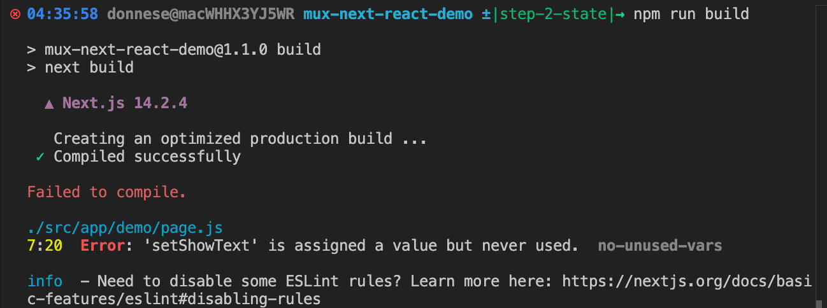
2. Managing state within an app
Catch-up command: `git checkout step-1-components`

Slide 15
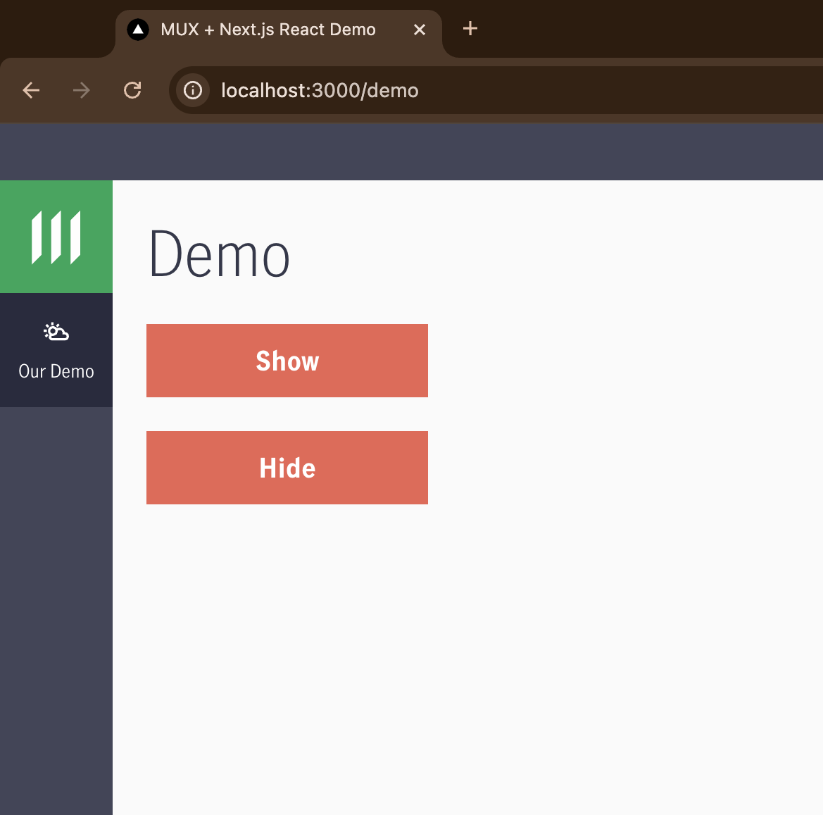
3. Event Handling
Catch-up command: `git checkout step-2-state`

Slide 16
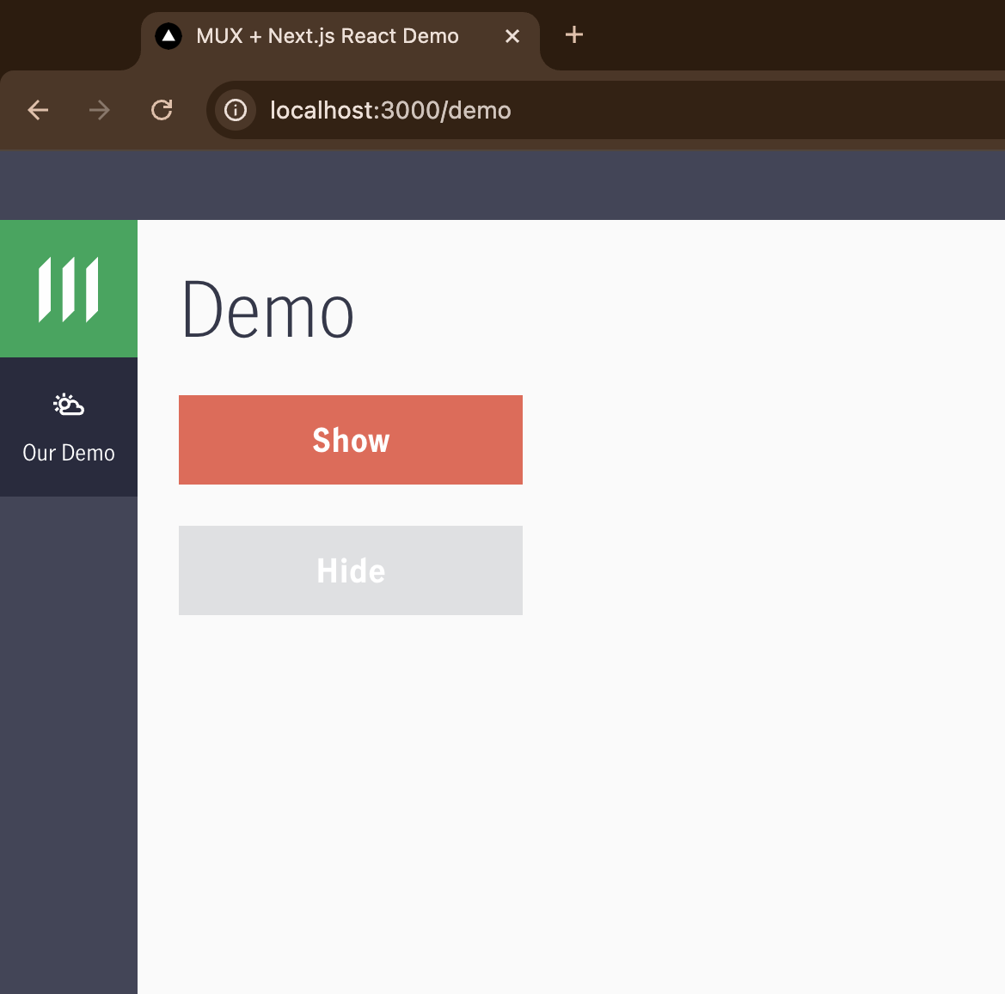
4. Conditional Props
Catch-up command: `git checkout step-3-event-handling`

Slide 17
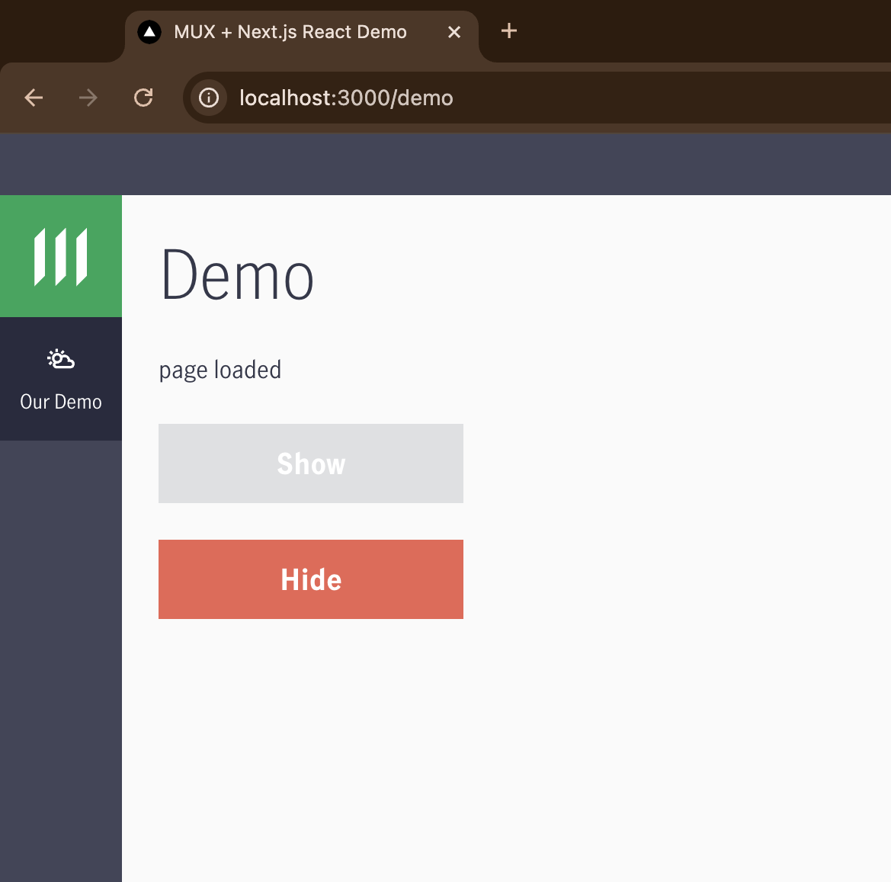
5. Using useEffect for page load events
Catch-up command: `git checkout step-4-conditional-props`

Slide 18
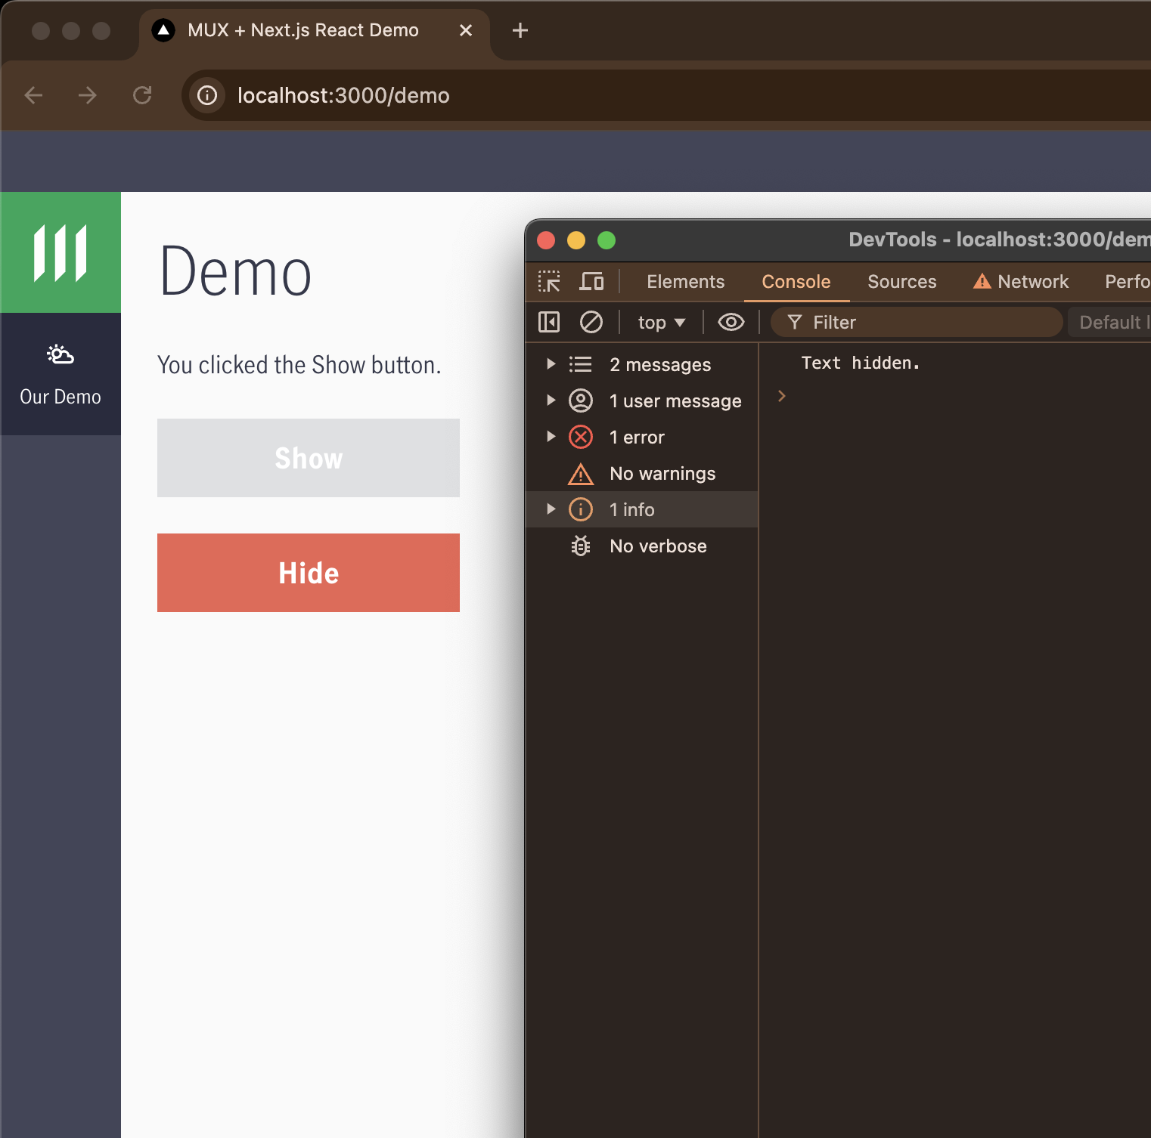
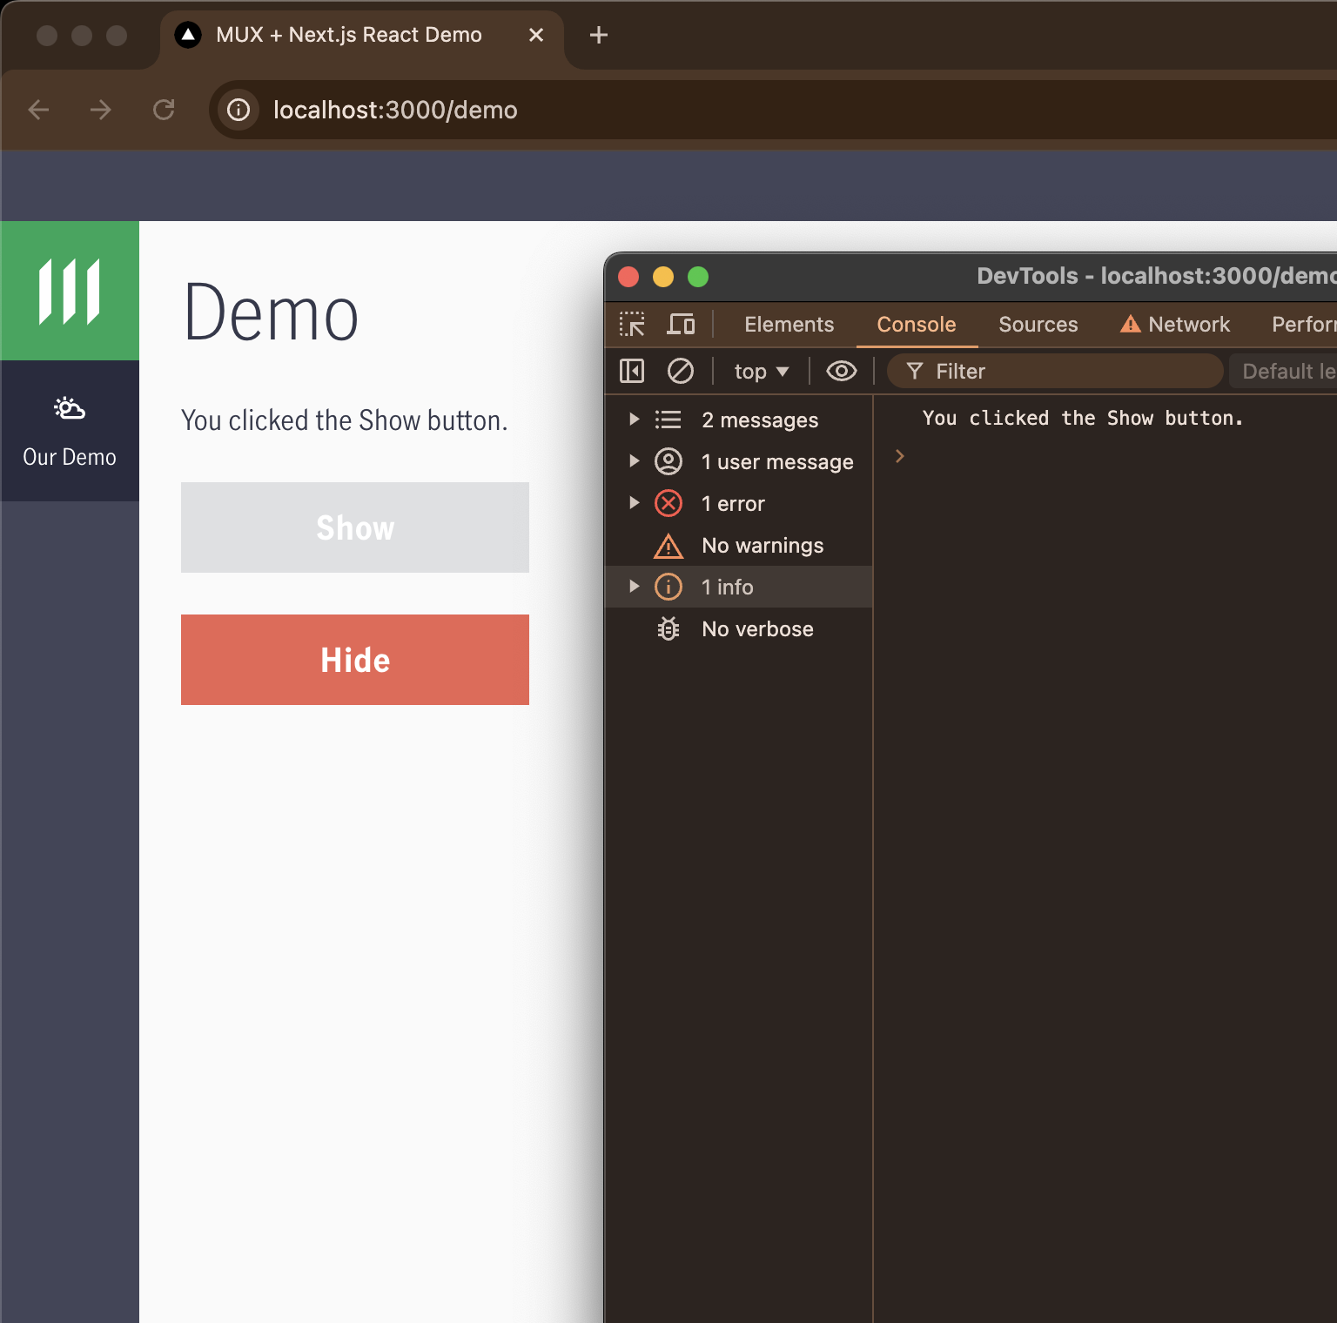
6. Using useEffect for dependency events
Catch-up command: `git checkout step-6-useEffect-depens-list-part-1`

Slide 19
Questions

